Slide 1
Databricks

Slide 2
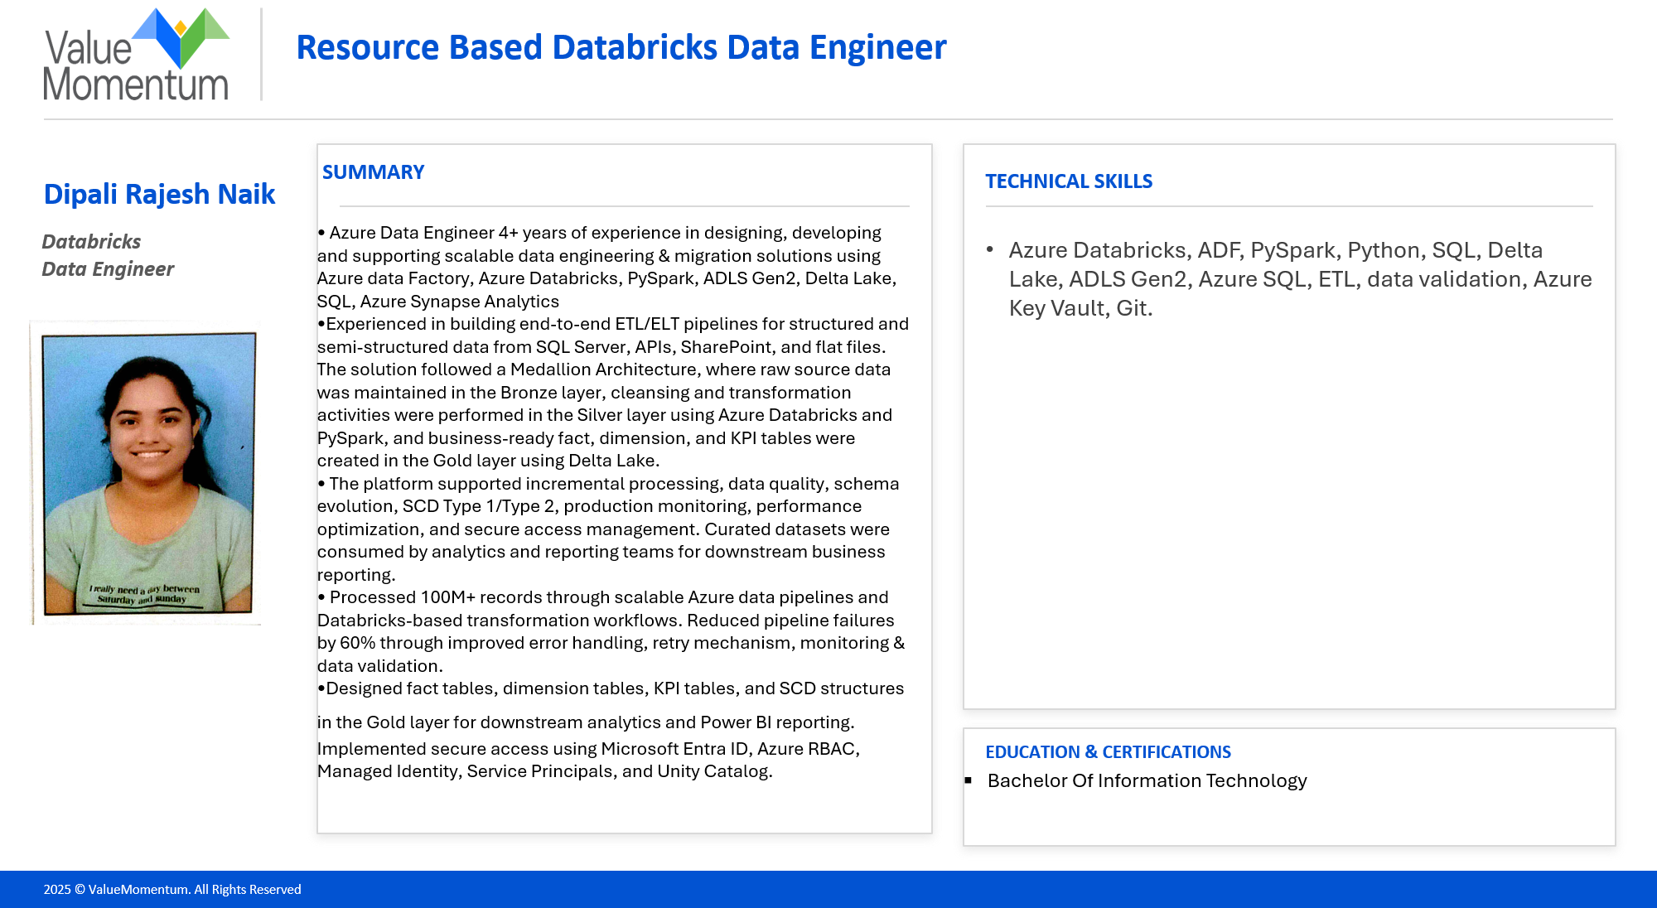

Slide 3

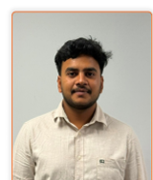
Resource Based Databricks Data Engineer
Srinivasa Bhargav
Pothineni
SUMMARY
TECHNICAL SKILLS
• Experienced Data Engineer with 3+ years in Databricks, ADF and Cloud Based Data Engineering Solutions
• Strong expertise in building scalable ETL pipelines, data ingestion frameworks, transformation logic, and end-to-end data validation across large enterprise datasets.
• Successfully taking care of requirement gathering, analysis, Team Building and leading.
• Proven experience in working with structured and semi-structured data, optimizing Spark jobs, and delivering high-performance data solutions for insurance and healthcare domains.
• Implemented data quality checks and incremental load strategies to support accurate policy lifecycle
•Developed scalable Azure Databricks pipelines for healthcare data ingestion, transformation, and validation across patient, provider, and claims-related datasets.
• Designed ETL workflows to standardize source data, apply business rules, and load trusted datasets into Delta Lake for analytics and operational reporting.
• Strong communication, troubleshooting, Problem Solving & Interpersonal skills, team-working attitude and self-motivation.
Azure Databricks, ADF, PySpark, Python, SQL, Delta Lake, ADLS Gen2, Azure SQL, ETL, data validation, performance tuning, Git, Power BI.
Databricks
Data Engineer(offshore)
EDUCATION & CERTIFICATIONS
B.tech in Computer Science Engineering
2025 © ValueMomentum. All Rights Reserved

Slide 4

Resource Based Databricks Data Engineer
Saikiran
Chagantipati
SUMMARY
TECHNICAL SKILLS
•Having 3+ yrs of experience as Data Engineer and Successfully migrated data from legacy systems to Azure Cloud using Databricks Medallion Architecture consisting of Bronze, Silver, and Gold layers on Delta Lake. Bronze stored raw source data, Silver handled cleansing and business transformations, while Gold contained curated datasets for reporting and analytics.
•Developed end-to-end ETL solutions using PySpark and Delta Lake to transform, validate, and optimize large-scale enterprise data.
•Strong expertise in Databricks, Azure, and data engineering best practices enables me to deliver reliable, business-ready data solutions.
•Participated in SIT and UAT activities for data migration projects, validating data accuracy, integrity and successful migration from source to target systems
Azure Databricks, Pyspark, SQL,Azure Tools, Azure Data Factory (ADF),Data Migration, Data Transformation, Medallion architecture,Delta Lake, MySQL, GitHub
Data Engineer
EDUCATION & CERTIFICATIONS
B.tech in Computer Science Engineering
Databricks Certified Data Engineer Associate
2025 © ValueMomentum. All Rights Reserved

Slide 5
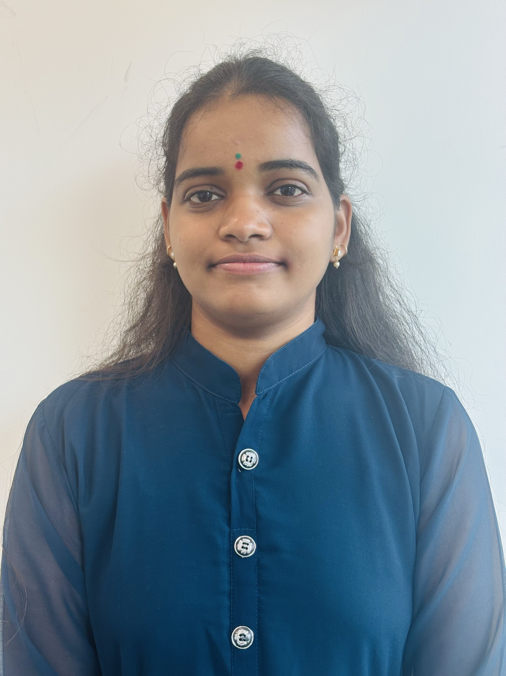
Resource Based Databricks Data Engineer
SUMMARY
TECHNICAL SKILLS
Data Engineer with 3+ years of hands-on experience in designing and maintaining data pipelines, ETL processes, and cloud-based architectures on Microsoft Azure.
Proficient in SQL, and data modelling concepts including star schema and SCD patterns.
Skilled in end-to-end project implementation and delivery of enterprise solutions in Data Warehousing and Data Integration landscapes using Azure Data Factory, Azure Synapse, and Microsoft Fabric.
Experienced in collaborating with analysts and data scientists to translate data requirements into reliable, production-grade pipelines. Holds 2 Microsoft certifications including DP-700.
Demonstrated ability to communicate effectively, resolve complex issues, and collaborate across teams, supported by strong interpersonal skills and a self-motivated approach in achieving goals.
Microsoft Azure – Azure Data Factory, Azure Databricks, Azure Synapse Analytics, Azure Data Lake Storage Gen2, Azure Blob Storage.
Microsoft Fabric – Fabric Data Factory, Lakehouse, Warehouse, Notebooks, SQL Endpoint
Data Modelling: Dimensional Modelling (Star & Snowflake Schema), SCD Type 1 & 2, OLTP to OLAP, Relational Databases
Saikaruna Paramaiahgari
Data Engineer
EDUCATION & CERTIFICATIONS
B.Tech in EEE — G. Narayanamma Institute of Technology & Sciences, Hyderabad, India | Aug 2018 – Aug 2022 | GPA: 8.2
Fabric Data Engineer Associate, Microsoft (DP-700)
Databricks Certified Data Engineer Associate, Issued by: Databricks
2025 © ValueMomentum. All Rights Reserved

Slide 6

Resource Based Databricks Data Engineer
SUMMARY
TECHNICAL SKILLS
3.3+ years of experience as a Data Engineer with hands-on work in Azure Databricks, ADF, PySpark, SQL and Azure-based data pipelines.
Experienced in building, validating, and optimizing ETL workflows for large and sensitive datasets, with strong focus on data quality, reconciliation, and reliable end-to-end delivery.
Skilled in developing scalable transformations using Databricks notebooks, Delta Lake, Azure Data Factory, Azure Data Lake Storage, and Azure SQL for batch data processing.
Strong background in healthcare domain data ,e-commerce and migration-style workflows, with the ability to adapt quickly to P&C insurance concepts such as claims, policy, billing, and downstream validation.
Effective communicator with the ability to work independently and collaborate with business, QA, and technical teams in fast-paced delivery environments.
Good knowledge of P&C Insurance domain with exposure to financial data
Microsoft Azure – Azure Data Factory, Azure Databricks, Azure Synapse Analytics, Azure Data Lake Storage Gen2, Azure Blob Storage.
Praveen Kumar Jonnalagadda
Data Engineer
EDUCATION & CERTIFICATIONS
B.Tech in CSE — Vel Tech University ,Chennai,India | Jun 2019 – jun2 023
Databricks Certified Data Engineer Associate
Databricks Certified Data Engineer Professional
2025 © ValueMomentum. All Rights Reserved

Slide 7

Resource Based Databricks Data Engineer
SUMMARY
TECHNICAL SKILLS
Software Engineer with 1+ year of hands-on experience in working with data pipelines and Designing and building ontologies, and BI solutions on Microsoft Fabric and Databricks.
Proficient in Python, SQL, and PySpark, with working knowledge of data modeling concepts including medallion architecture (Bronze-Silver-Gold) and Delta Lake optimization.
Skilled in end-to-end implementation of ontology-drive data solutions and Power BI reporting, including building Fabric IQ ontologies, a Claims Pipeline Data Agent, and an OntoBricks-based insurance claims knowledge graph over P&C Claims and Policy data.
Experienced in translating business requirements into production-grade dashboards and semantic data models, with a strong focus on data reconciliation and quality. Holds the Databricks Certified Data Engineer Associate certification (Sept 2026).
Databricks, Delta Lake, PySpark, OntoBricks, Microsoft Fabric, Fabric IQ, Power BI, Python, SQL, Medallion Architecture, Ontology Modeling, Git.
Aswin Murugan
Data Engineer
EDUCATION & CERTIFICATIONS
B.E in CSE —Dhaanish Ahmed Institute of Technology, Tamil Nadu, India | 2021 – 2025 | GPA: 8.0
Databricks Certified Data Engineer Associate, Issued by: Databricks [Sept 2026]
2025 © ValueMomentum. All Rights Reserved

Slide 8
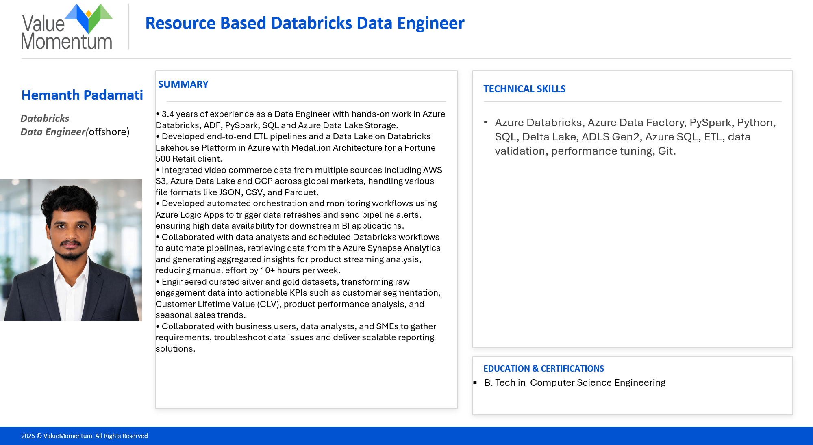

Slide 9
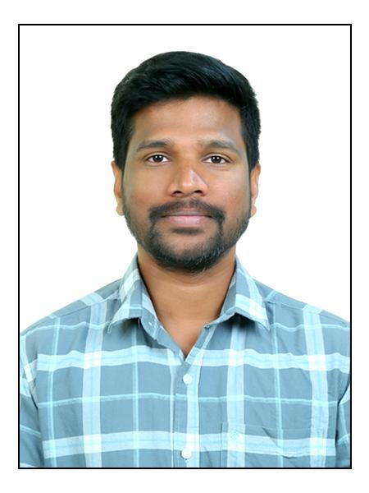
Resource Based Databricks Data Engineer
Abhilash Sudhala
SUMMARY
TECHNICAL SKILLS
Data Engineer with 5+ years of experience in Azure Databricks, Azure Data Factory (ADF), and cloud-based data engineering solutions.
Experienced in designing scalable ETL/ELT pipelines, metadata-driven ingestion frameworks, data transformations, and end-to-end data validation.
Hands-on experience working with structured and semi-structured data, optimizing Spark workloads, and developing high-performance data solutions across Retail, Manufacturing & Supply Chain domains.
Implemented data quality validations, reconciliation processes incremental loading, and error-handling strategies to ensure data accuracy, reliability, and consistent data processing.
Developed and maintained Azure Databricks pipelines for ingestion, transformation, validation, and processing of retail, manufacturing, sales, and supply chain data.
Designed ETL workflows using PySpark and SQL to standardize source data, implement business rules, perform transformations, and build Bronze, Silver, and Gold data layers using Medallion Architecture and Delta Lake.
Collaborated with business stakeholders and data teams to translate requirements into scalable data solutions, optimize data pipelines, and deliver trusted datasets for analytics and reporting.
Azure Databricks, Azure Data Factory, PySpark, Python, SQL, Delta Lake, ADLS Gen2, Azure Synapse, Azure SQL, ETL/ELT, Medallion Architecture, Data validation, performance tuning, Git, Azure DevOps, Power BI.
Databricks
Data Engineer(offshore)
EDUCATION & CERTIFICATIONS
MBA in Finance from Hasvita Institute of Management and Technology (HIMT) Osmania University
Fabric Data Engineer Associate, Microsoft (DP-700)
2025 © ValueMomentum. All Rights Reserved

Slide 10
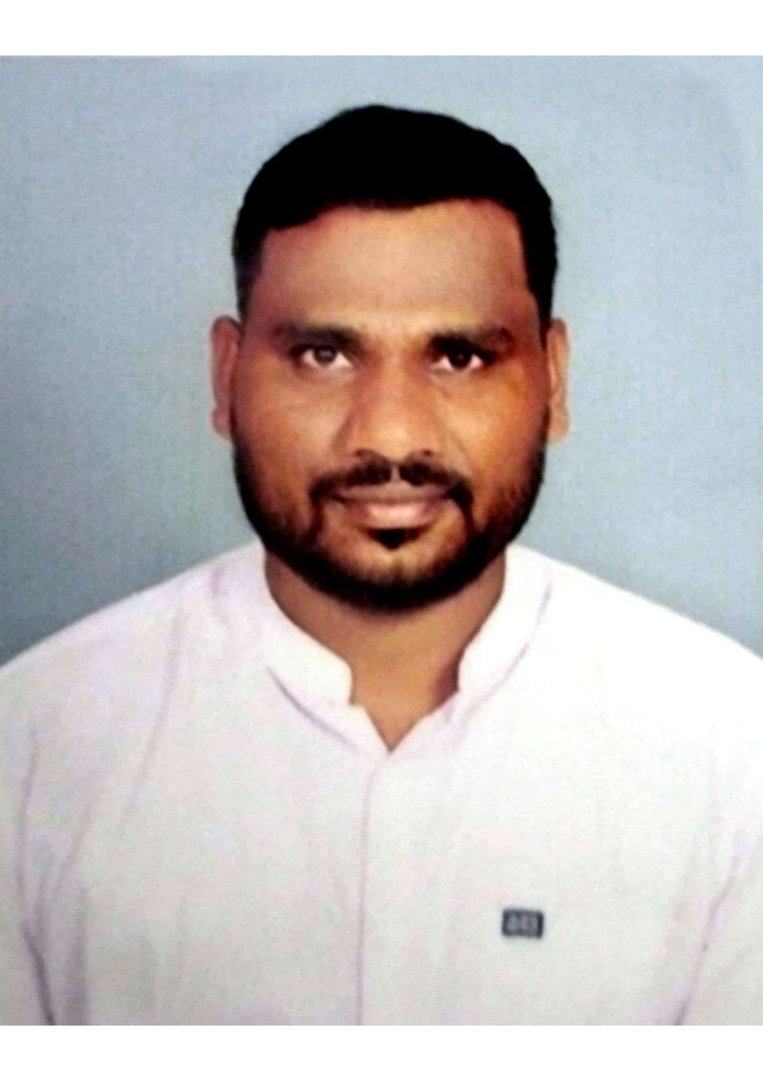
Resource Based Databricks Data Engineer
Balaram Pulusu
SUMMARY
TECHNICAL SKILLS
Results-driven Data Engineer with 6+ years of experience designing and implementing scalable data pipelines using PySpark, AWS, SQL, and Databricks.
Experienced in developing end-to-end ETL workflows covering raw ingestion, validation, transformation, curated aggregations, and production support for large-scale transactional datasets.
Hands-on experience with AWS Glue, Amazon S3, Athena, EMR, Spark SQL, Parquet, and Databricks, including migration of existing AWS Glue ETL workloads to Databricks.
Strong knowledge of Spark performance optimization, including partitioning, repartitioning, predicate pushdown, and shuffle reduction techniques.
Experienced in data quality validation, schema validation, duplicate and null checks, record-count validation, business-rule validation, troubleshooting, and root-cause analysis.
Experienced in ETL scheduling, dependency management, CI/CD, code reviews, and production deployments using Stonebranch, Jenkins, and Bitbucket.
Collaborated with business, QA, and upstream teams for requirement analysis, testing, production support, and deployment activities.
Databricks, AWS, PySpark, Python, SQL, Delta Lake, AWS Glue, Stepfunction,S3,EMR, data validation, performance tuning, Git.
Databricks
Data Engineer(offshore)
EDUCATION & CERTIFICATIONS
B.tech in Electronics and Communication Engineering
2025 © ValueMomentum. All Rights Reserved

Slide 11

Resource Based Databricks Data Engineer
Indrasenareddy
Madhireddy
SUMMARY
TECHNICAL SKILLS
2 years of experience as a Data Engineer with hands-on work in Azure Databricks, ADF, PySpark, SQL and Azure-based data pipelines.
Experienced in building, validating, and optimizing ETL workflows for large and sensitive datasets, with strong focus on data quality, reconciliation, and reliable end-to-end delivery.
Skilled in developing scalable transformations using Databricks notebooks, Delta Lake, Azure Data Factory, Azure Data Lake Storage, and Azure SQL for batch data processing.
Strong background in Retail domain data and migration-style workflows, with the ability to adapt quickly to P&C insurance concepts such as claims, policy, billing, and downstream validation.
Effective communicator with the ability to work independently and collaborate with business, QA, and technical teams in fast-paced delivery environments.
Good knowledge of P&C Insurance domain with exposure to financial data
Azure Databricks, ADF, PySpark, Python, SQL, Delta Lake, ADLS Gen2.
Databricks
Data Engineer(offshore)
EDUCATION & CERTIFICATIONS
B.Tech in Information Technology
2025 © ValueMomentum. All Rights Reserved

Slide 12

Resource Based Databricks Data Engineer
Mayank Sahu
SUMMARY
TECHNICAL SKILLS
Data Engineer with 2.5 years of experience in Azure Databricks, Azure Data Factory (ADF), PySpark, Python, SQL, and Azure-based data engineering solutions.
Databricks Certified Data Engineer Associate with expertise in designing and developing scalable ELT pipelines, metadata-driven ingestion frameworks, and transformation workflows for large-scale enterprise datasets.
Experienced in building end-to-end data ingestion, transformation, and processing solutions using Azure Databricks, Delta Lake, ADLS Gen2, and Azure Data Factory.
Strong hands-on experience in implementing Medallion Architecture (Bronze, Silver, Gold) to create scalable, governed, and analytics-ready data platforms.
Skilled in implementing CDC and watermark-based incremental loading, data validation, reconciliation, and performance optimization to ensure reliable and high-quality data delivery.
Collaborated with business stakeholders and cross-functional teams to translate requirements into scalable data solutions and deliver trusted datasets for analytics, reporting, and decision-making.
Databricks
Data Engineer
Azure Databricks, Azure Data Factory, PySpark, Python, SQL, Delta Lake, Azure Data Lake Storage Gen2, Azure SQL, ELT, data validation.
EDUCATION & CERTIFICATIONS
B.Tech in Computer Science Engineering
Databricks Certified Data Engineer Associate
2025 © ValueMomentum. All Rights Reserved

Slide 13
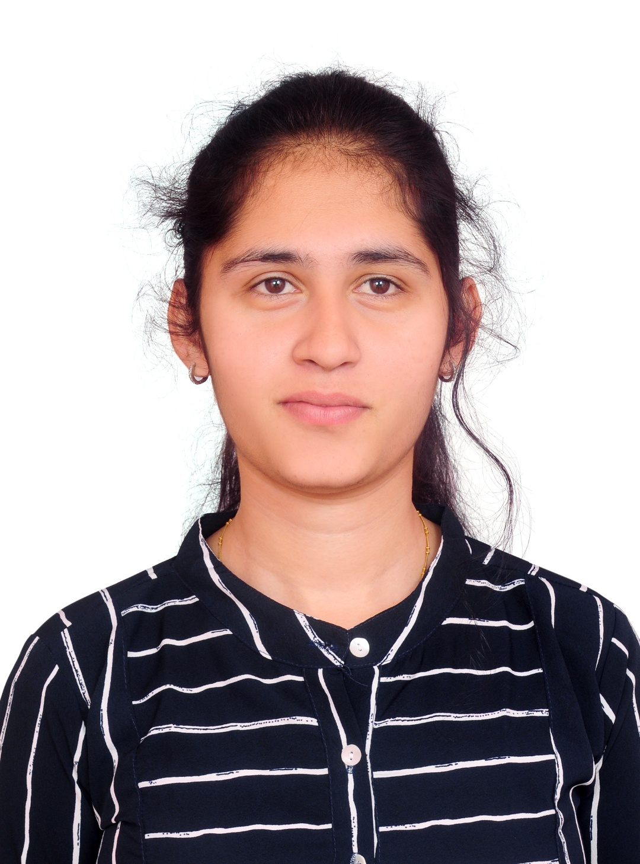
Resource Based Databricks Data Engineer
Divya Namburi
SUMMARY
TECHNICAL SKILLS
Experienced Data Engineer with 5+ years of experience in Databricks, Azure Data Factory, PySpark, SQL, Azure Synapse Analytics, Azure SQL Database, ADLS Gen2, and CosmosDB.
Strong expertise in building scalable end-to-end ETL/ELT pipelines using Medallion Architecture for enterprise data ingestion, transformation, validation, reconciliation, and migration workloads.
Experienced in Retail and Manufacturing/Industrial domains, working with complex business processes, multiple business entities, and large-scale enterprise data.
Experienced in enterprise-scale data migration involving complex data mappings, structured and semi-structured datasets, and high-volume data processing.
Hands-on experience with ADF, Databricks, PySpark, Spark SQL, and Delta Lake, with strong focus on performance optimization through partitioning, batching, and parallel processing.
Managed a team of 4 Data Engineers, providing technical guidance, establishing engineering standards, reviewing deliverables, and coordinating with architects, analysts, and business stakeholders.
Developed scalable cloud data solutions supporting multiple enterprise business entities, with emphasis on reusable, secure, and maintainable pipelines.
Strong experience in data validation, transformation, reconciliation, troubleshooting, CI/CD, and performance tuning.
Azure & Data Engineering: Databricks, Azure Data Factory, ADLS Gen2, Synapse Analytics, SQL server, ETL/ELT, Medallion Architecture, Key Vault, Logic Apps, CosmosDB, Data Migration, Data Modelling.
Programming & Data Processing: SQL, PySpark, Spark SQL, Python, Apache Spark, Delta Lake, Data Validation, Data Reconciliation, Performance Tuning, Azure DevOps
Databricks
Senior Data Engineer
EDUCATION & CERTIFICATIONS
Bachelor of Technology from Presidency University, Bengaluru, 2021.
Databricks Certified Data Engineer Associate Certification.
Microsoft Certified: Azure Data Engineer associate (DP-203)
Microsoft Certified: Fabric Data Engineer Associate(DP-700)
2025 © ValueMomentum. All Rights Reserved

Slide 14

Resource Based Databricks Data Engineer
Srija Kotipalli
SUMMARY
TECHNICAL SKILLS
Databricks Certified Data Engineer Associate with 3.5+ years of experience designing and delivering enterprise-scale data engineering solutions on Azure and Databricks platforms.
Expertise in building scalable ETL/ELT pipelines using Azure Databricks, PySpark, Azure Data Factory (ADF), ADLS, and Azure SQL Database, enabling reliable and high-performance data processing.
Played a key role in large-scale Oracle PL/SQL to Databricks migration initiatives, accelerating cloud modernization and reducing dependency on legacy data platforms.
Developed metadata-driven and reusable data frameworks that improved development efficiency, streamlined deployments, and reduced manual effort across multiple environments.
Designed and implemented Medallion Architecture (Bronze, Silver, Gold) and Delta Lake solutions to support trusted, analytics-ready datasets for business reporting and decision-making.
Worked on data ingestion, transformation, validation, and reconciliation processes to ensure data accuracy and support business reporting.
Strong background in performance tuning, troubleshooting, production support, and optimizing data workloads for scalability, reliability, and maintainability.
Passionate about leveraging modern cloud and data technologies to transform business data into actionable insights and drive data-driven decision-making.
Programming Languages: SQL, Python, PySpark
Cloud Platforms: Microsoft Azure (ADF, ADB, ADLS, Azure SQL, Azure Functions, Logic Apps)
Data Processing: Azure Data Factory, Data Pipelines, Medallion Architecture
Data Governance: Unity Catalog, Row-Level Security & Azure Key Vault
Integration: Salesforce Integration
Databricks
Data Engineer
EDUCATION & CERTIFICATIONS
Bachelor of Technology from JNTUK.
Databricks Certified Data Engineer Associate – Databricks(2026)
2025 © ValueMomentum. All Rights Reserved

Slide 15
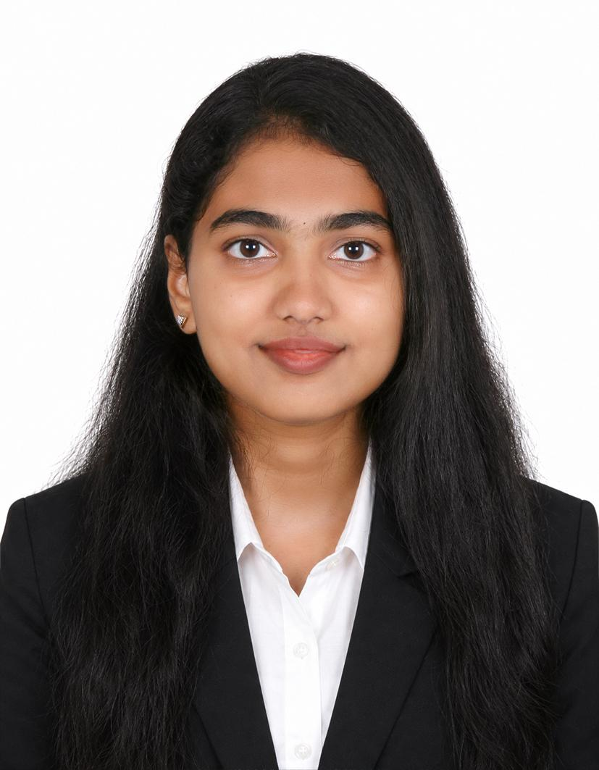
Resource Based Databricks Data Engineer
SUMMARY
TECHNICAL SKILLS
Software Engineer with 1+ year of hands-on experience in delivering BI solutions, designing domain ontologies, and working with data pipelines using Microsoft Fabric and Databricks.
Proficient in SQL ,Python, PySpark, Databricks and Power BI , with working knowledge of ETL, data warehousing and data modeling.
Experienced in building Power BI dashboards and reports, developing DAX measures and KPIs to translate business requirements into actionable insights.
Designed and implemented an OntoBricks-based ontology for Property & Casualty (P&C) insurance data within the Databricks Lakehouse, defining business entities, relationships, and semantic structures to support data analysis and AI-driven use cases.
Strong understanding of insurance business processes and requirements, with the ability to translate business insights into scalable data solutions, semantic models, and actionable reporting frameworks.
SQL, Python, PySpark, Databricks, Power BI,Microsoft Fabric, Delta Lake, OntoBricks,MS SQL Server, PostgreSQL
Kavya Shree Ramasamy
Data Engineer
EDUCATION & CERTIFICATIONS
B.E in CSE —Dr N.G.P Institute of Technology, Tamil Nadu, India | 2021 – 2025 | GPA: 9.0
Databricks Certified Data Engineer Associate, Issued by: Databricks [Sept 2026]
2025 © ValueMomentum. All Rights Reserved

Slide 16
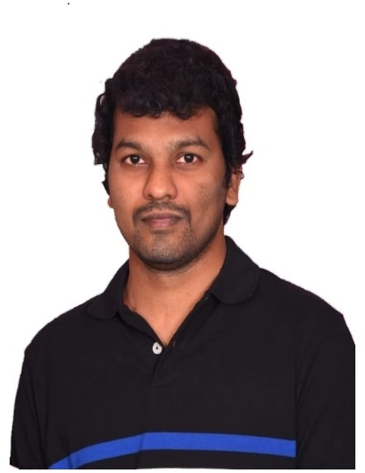
Resource Based Databricks Data Engineer
Anudeep Gurrala
SUMMARY
TECHNICAL SKILLS
Data Engineer with 6+ years of experience in developing and implementing data solutions using Oracle PL/SQL and Databricks. Skilled in designing, developing, optimizing, and maintaining data pipelines and database solutions to enable scalable, reliable, and efficient data processing.
Extensive experience in developing Stored Procedures, Functions, Triggers, Views, Packages, Exception Handling, Joins, Cursors, Collections/Arrays and Types.
Proficient in creation of database objects like Tables, Views, Triggers, Synonyms, Indexes and extensive use of DDL and DML scripts for enhancing the design of product.
Hands on Cursors, Bulk Binding Process and Collections in Oracle for better performance.
Utilized Joins, Subqueries to simplify complex queries involving multiple tables.
Well-versed in SQL subqueries, applying constraints, and creating and optimizing views and indexes.
Worked on Databricks creating solutions, procedures and transforming data
Skilled in leveraging Azure services (Databricks, Data Lake Storage) to design and implement efficient data pipelines
Practical experience with PySpark, SQL, Databricks, and Delta Lake for developing data pipelines, transformations, and scalable data processing solutions.
Quick learner with the ability to adapt to emerging technologies, with strong communication and interpersonal skills
Programming Languages: SQL, PL/SQL, PySpark
Cloud Technologies: Azure Databricks
Data Transformation & ETL Tools: Data bricks, Oracle Data Integrator (ODI)
Tools: PLSQL developer, SQL developer, ODI, GitHub
Databricks
Data Engineer
Bachelor of Technology from JNTUK.
EDUCATION & CERTIFICATIONS
2025 © ValueMomentum. All Rights Reserved

Slide 17

Resource Based Databricks Data Engineer
Rohith Goud Alijala
SUMMARY
TECHNICAL SKILLS
Databricks
Senior Data Engineer
Data Engineer with 4+ years of enterprise software development experience, specializing in Azure Databricks, PySpark, Python, SQL, ADF, ADLS, and Delta Lake​
Developed and supported end-to-end ETL/ELT pipelines for data ingestion, transformation, validation, and incremental loading using ADF and Databricks.
Implemented Bronze, Silver, and Gold layers using Databricks Medallion Architecture and maintained Delta Tables for analytics and reporting.. ​
Built PySpark/Python data processing for cleansing, transformation, aggregation, business rules, and data validation. ​
Developed reusable ADF pipelines using Copy, Lookup, ForEach, Stored Procedure, Parameters, and Variables. ​
Implemented data-quality checks, source-to-target reconciliation, duplicate/null/schema validation, and production troubleshooting.
Worked closely with developers, QA, analysts, and business stakeholders to deliver data solutions and resolve production issues. ​
Azure, Databricks, PySpark, Python, SQL, ADF, ADLS, Delta Lake, ETL/ELT, Data Processing, Data Transformation, Data Validation, Data Quality, MySQL, Git, GitHub, Jira, CI/CD
EDUCATION & CERTIFICATIONS
B.Tech – Mechanical Engineering
Nalla Narasimha Reddy Group of Institutions, JNTUH | 2021 | CGPA: 7.1
2025 © ValueMomentum. All Rights Reserved

Slide 18

Resource Based Databricks Data Engineer
Dinesh Kommu
SUMMARY
TECHNICAL SKILLS
Azure Data Engineer with 5+ years of experience designing and delivering enterprise-scale data engineering and analytics solutions on Azure Cloud and Databricks platforms.
Expertise in building metadata-driven and reusable data ingestion frameworks using Azure Databricks, Azure Synapse Analytics, Azure Data Factory (ADF), ADLS Gen2, PySpark, Python, and SQL.
Strong experience integrating and processing data from diverse enterprise sources, including SAP ECC, SAP HANA, Oracle ERP, Azure SQL Database, AWS S3, Salesforce, WebOps, and Varicent.
Architected and implemented Medallion Architecture (Bronze, Silver, and Gold layers) using Delta Lake and Delta Live Tables (DLT) to deliver trusted, scalable, and analytics-ready data products.
Hands-on experience developing Delta Live Tables (DLT), CDC pipelines, data quality frameworks, and monitoring solutions to ensure data reliability, governance, and operational excellence.
Built metadata-driven orchestration and automation frameworks that accelerated onboarding of new data sources, improved development productivity, and significantly reduced manual effort.
Designed and developed Fact and Dimension data models to support enterprise reporting, self-service analytics, and business intelligence solutions using Power BI.
Strong background in performance tuning, troubleshooting, production support, and optimization of large-scale distributed data processing workloads.
Passionate about leveraging modern cloud, lakehouse, and data engineering technologies to transform complex business data into actionable insights and drive data-driven decision-making.
Programming Languages: Python, PySpark, SQL
Cloud & Analytics Platforms: Microsoft Fabric, Azure Databricks, Azure Synapse Analytics, Azure Data Factory (ADF), ADLS Gen2, Azure SQL Database,Microsoft Fabric
Reporting & Analytics: Power BI
Data Governance & Security: Unity Catalog, Azure Key Vault
DevOps & CI/CD: Azure DevOps
Databricks
Data Engineer
EDUCATION & CERTIFICATIONS
Bachelor of Technology from GMR IT
Databricks Certified Data Engineer Associate – Databricks(2026)
Databricks Ceritified Data engineer Professional –Databricks(2026)
2025 © ValueMomentum. All Rights Reserved

Slide 19

Resource Based Databricks Data Engineer
Veera Malleswara
Rao
Somula
SUMMARY
TECHNICAL SKILLS
Azure Data Engineer with 4.2 years of experience in designing, developing, and maintaining scalable ETL/ELT data pipelines using Microsoft Azure services.
Strong experience with Azure Data Factory (ADF) for developing end-to-end data integration pipelines, Mapping Data Flows, parameterized workflows, scheduling, dependencies, monitoring, and alerting.
Hands-on experience with Azure Databricks, PySpark, and Spark SQL for data extraction, transformation, cleansing, joins, aggregations, deduplication, and business-rule implementation.
Proven experience working with structured and semi-structured data, optimizing Spark workloads, and delivering scalable, high-performance data solutions across insurance and healthcare domains.
Experienced in implementing full-load and incremental-load frameworks, including watermark-based incremental processing for efficient and scalable data ingestion.
Experienced in implementing Medallion Architecture (Bronze, Silver, and Gold) using Delta Lake and integrating curated datasets into Azure Synapse Analytics for analytics and reporting.
Designed and developed ETL workflows to standardize source data, apply business rules, perform data transformations, and load trusted datasets into Delta Lake for analytics and operational reporting.
Azure Databricks
Azure Data Factory
Delta Live Tables
PySpark
ADLS Gen2
SQL
Data Validation and Analysis
Delta Lake
Databricks
Data Engineer(offshore)
EDUCATION & CERTIFICATIONS
BSc in Computer Science
2025 © ValueMomentum. All Rights Reserved

Slide 20
Resource Based Databricks Data Engineer
SUMMARY
TECHNICAL SKILLS
Data Engineer with 4.1 years of experience in designing, developing, and optimizing scalable data pipelines and ETL solutions using cloud-based data engineering technologies.
Hands-on experience with Azure Databricks, PySpark, Python, SQL, Delta Lake, ADLS Gen2, and Kafka, developing reliable data ingestion and transformation workflows.
Experienced in designing Lakehouse solutions using Medallion Architecture, supporting structured processing of complex and hierarchical healthcare data.
Strong experience in data transformation, data quality, incremental processing and deduplication using scalable data engineering practices.
Experienced in developing reusable and parameterized data processing frameworks, reducing code duplication and improving maintainability across multiple datasets and tables.
Skilled in Spark and Delta Lake performance optimization, with experience improving pipeline efficiency through incremental processing, filtering, partitioning, and join optimization.
Experienced in data pipeline monitoring, audit logging, CI/CD, and production support, while collaborating with cross-functional teams in Agile/Scrum environments.
Programming Languages: Pyspark, SQL, Python, SparkSQL
ETL and Data Processing Platforms: Databricks, ADF, Delta lake
Streaming Tools: Kafka, Spark Structured Streaming
Cloud Platforms: Azure, ADLS Gen2
Version Control: Git, Azure Devops, CI/CD
Sai Kalyani Peram
Data Engineer
EDUCATION & CERTIFICATIONS
B.Tech in CSE — Gokaraju RangaRaju Institute of Engineering and Technology
Certified Data Engineer Professional, Issued by: Databricks
Microsoft Certified: Azure Fundamentals (AZ-900) • Microsoft Certified: Azure Data Fundamentals( DP-900)
2025 © ValueMomentum. All Rights Reserved

Slide 21

Resource Based Databricks Data Engineer
Rajni Kumari
SUMMARY
TECHNICAL SKILLS
• Certified Data Engineer with 4+ years of experience in ETL development, data integration, and data engineering, with hands-on experience in Databricks, PySpark, Python, SQL, ADF, Azure SQL, Delta Lake, Oracle, PL/SQL, and ODI.
• Experienced in the P&C Insurance domain, working on data processing, transformation, and integration requirements.
• Skilled in building, troubleshooting, and optimizing data pipelines, including full-load, incremental-load, and batch processing, with focus on performance, data quality, and production issue resolution.
• Experience in data migration and modernization initiatives, with knowledge of Data Warehousing, Data Modelling, Dimensional Modelling, SCD, and Delta Lake.
• Developed metadata-driven and reusable data frameworks that improved development efficiency, streamlined deployments, and reduced manual effort across multiple environments.
• Experienced in end-to-end conversion of ODI mappings and loadplans to Databricks, including workflow orchestration, reusable notebook development, incremental data processing, audit implementation, testing, troubleshooting, and deployment.
Programming Languages: SQL, Python, PySpark, Spark SQL
Cloud Platforms: Microsoft Azure (ADF, ADB, ADLS, Azure SQL, Azure Functions, Logic Apps)
Data Processing: Azure Data Factory, ETL/ELT, Data Pipelines, Medallion Architecture , Data Modeling
Data Governance: Unity Catalog, Azure Key Vault
CI/CD: GitHub, Databricks Asset Bundles
Databricks
Data Engineer
EDUCATION & CERTIFICATIONS
Bachelor of Technology (CSE) from Netaji Subhash Engineering College , West Bengal
Databricks Certified Data Engineer Associate | Microsoft Certified: Azure Data Engineer Associate
2025 © ValueMomentum. All Rights Reserved

Slide 22

Resource Based Databricks Data Engineer
Vinay Samala
SUMMARY
TECHNICAL SKILLS
•Azure Data Engineer with 3+ years of experience in designing, developing, and maintaining scalable ETL/ELT data pipelines and cloud-based data solutions using Microsoft Azure technologies.
• Strong expertise in Azure Databricks, Azure Data Factory (ADF), PySpark, and SQL for building efficient data ingestion, transformation, and processing frameworks.
• Experienced in developing end-to-end data engineering solutions using Azure Databricks, Delta Lake, ADLS Gen2 to support enterprise analytics and reporting requirements.
• Hands-on experience implementing Medallion Architecture (Bronze, Silver, and Gold layers) to build scalable, governed, and analytics-ready data platforms.
• Skilled in implementing incremental data processing using CDC and watermark-based loading techniques, along with data validation, and performance optimization for reliable data delivery.
• Proven ability to collaborate with business stakeholders and cross-functional teams to translate requirements into scalable data solutions and deliver trusted datasets for analytics, reporting and decision-making.
Databricks
Data Engineer(offshore)
Azure Data Factory (ADF), Azure Databricks, Azure Data Lake Storage Gen2 (ADLS Gen2), Data Processing, Data Validation, Data Quality, Delta Lake, PySpark, Spark SQL, SQL Server, Azure Monitor.
EDUCATION & CERTIFICATIONS
Masters from Osmania University.
2025 © ValueMomentum. All Rights Reserved

Slide 23
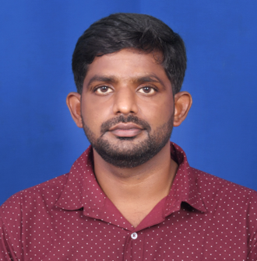
Resource Based Databricks Data Engineer
Satish Kumar Peddireddy
SUMMARY
TECHNICAL SKILLS
Databricks
Senior Data Engineer
Databricks Certified Data Engineer Associate with 10 years of experience in creating and managing robust big data pipelines for seamless ETL using Azure Data Factory, Azure Databricks, Spark, SQL Server and Excel.
Designed and implemented Databricks Delta Lake solutions ensuring ACID transactions, data versioning, and time-travel capabilities for enhanced data quality and traceability.
Led a Data Lake project to transfer Guidewire policy data from ODS to Cloudera Data Platform (CDP) on Azure — loaded data for 2,640 tables across sandbox, development and QA environments.
Skilled in data ingestion, quality checks and independently delivering high-quality solutions with minimal team support.
Integrated and processed data from multiple sources handling JSON, CSV and Parquet file formats.
Performed rigorous source-to-target validation and record count comparisons across ingestion and curation lifecycle.
Monitored production processes for SLA adherence, conducted root cause analysis and performed performance tuning for slow-running tasks.
Cloud: Azure Data Factory (ADF), Azure Databricks, ADLS Gen2, Delta Lake, Azure Storage
Big Data: Hadoop, Hive HQL, PySpark, Spark SQL, YARN
Programming: Python, SQL, Shell Scripting
Databases: MySQL, DB2, Oracle
Tools: Control-M, Ab Initio, CA7, Zena
Domain: P&C Insurance (Commercial, Auto, Home, Workers Compensation)
EDUCATION & CERTIFICATIONS
Bachelors in Information Technology
Databricks Certified Data Engineer Associate - June 2025
2025 © ValueMomentum. All Rights Reserved

Slide 24

Resource Based Databricks Data Engineer
Mahendra Gali
SUMMARY
TECHNICAL SKILLS
• Azure Data Engineer with 4+ years in designing and developing ETL/ELT and data-processing solutions using Databricks and ADF.
• Experienced in building Bronze/Silver/Gold Medallion Architecture, Full and incremental data pipelines.
• Experienced in implementing Unity Catalog, Azure Key Vault for governance and data lenage.
• Proven experience in working with structured and semi-structured data, optimizing Spark jobs, and delivering high-performance data solutions for insurance and retails domain
• Implemented data quality checks and incremental load strategies to support accurate data.
•Developed scalable Azure Databricks pipelines for Retail and Insurance data ingestion, transformation, and validation across Sales, provider, and claims-related datasets.
• Designed ETL workflows to standardize source data, apply business rules, and load trusted datasets into Delta Lake for analytics and operational reporting.
• Strong communication, troubleshooting, Problem Solving & Interpersonal skills, team-working attitude and self-motivation.
Azure Databricks, ADF, PySpark, SQL, SQL Server, Delta Lake, ADLS Gen2, Azure SQL, ETL, data validation, Unity Catalog,
Databricks
Data Engineer
EDUCATION & CERTIFICATIONS
B.E in Electronics and Communication Engineering
2025 © ValueMomentum. All Rights Reserved

Slide 25

Resource Based Databricks Data Engineer
Padala Naga Sri Sai
Prasad Reddy
SUMMARY
TECHNICAL SKILLS
• Data Engineer with 3+ years of experience as a Data Engineer with hands-on work in Azure Databricks, ADF, PySpark, Spark SQL and Delta Lake.
• Experienced in building ETL/ELT pipelines using Medallion architecture, incremental loads and data validation frameworks.
• Improved processing efficiency by ~40% and data consistency by ~30%; supported validation of 500+ datasets monthly.
• Skilled in data reconciliation, data quality checks and root-cause analysis across JSON, CSV and Parquet sources.
•Experienced in UAT, defect analysis and production support, collaborating with business, QA and technical teams in Agile/Scrum.
• Orchestrated Databricks jobs through ADF and Databricks Workflows, reducing manual processing effort.
• Performed root-cause analysis of pipeline failures and supported UAT and deployments.
• Built Spark SQL exception reports highlighting mismatched, missing and late-arriving records for business and QA teams.
• Performed root-cause analysis of pipeline failures and supported UAT and deployments.
Azure Databricks, ADF, PySpark, SQL, SQL Server, Delta Lake, ADLS Gen2, Azure SQL, ETL, data validation, Unity Catalog,
Databricks
Data Engineer
EDUCATION & CERTIFICATIONS
B.Tech in computer science
2025 © ValueMomentum. All Rights Reserved

Slide 26

Resource Based Databricks Data Engineer
Abhiram Pedamallu
SUMMARY
TECHNICAL SKILLS
1.10 years of comprehensive experience in Data Engineering, with exposure to the Insurance (Property & Casualty) domain and large-scale data migration projects.
Practical experience with PySpark, SQL, Databricks, and Delta Lake for developing data pipelines, transformations, and scalable data processing solutions.
Experience designing metadata-driven automation frameworks for large-scale Oracle-to-Databricks migrations, including schema extraction, Delta table creation, and data ingestion.
Hands-on experience migrating ~9 TB of data per Oracle environment across 5,000+ tables, using JDBC and GoldenGate, Amazon S3, and Delta Lake.
Experience in using equivalent partitioning, indexing, and column cardinality from on prem SQL and implementing appropriate Delta Lake optimization strategies, including partitioning and Z-Ordering/clustering.
Experience analyzing and migrating ODI-based ETL processes, including mappings, packages, Knowledge Modules, and incremental pipelines using PySpark, SQL, and SCD patterns.
Experience analyzing PL/SQL packages and business logic, including stored procedures and functions, and transforming the underlying SQL/PLSQL logic into Python/PySpark implementations for Databricks-based processing.
Experience building and maintaining data pipelines using Azure Data Factory, ADLS, and Databricks, including scheduling, monitoring, troubleshooting, and ETL validation.
Azure Databricks, PySpark, Spark SQL, Delta Lake, ADLS Gen2,Amazon S3, ETL, Unity Catalog, Azure Data Factory , GitHub
Databricks
Data Engineer
EDUCATION & CERTIFICATIONS
B.E in Information Technology. Graduated in 2024
2025 © ValueMomentum. All Rights Reserved

Slide 27

Resource Based Databricks Data Engineer
Harshini
Mummareddy
SUMMARY
TECHNICAL SKILLS
Data Engineer with 6+ years of experience in Azure Databricks, Azure Data Factory (ADF), and cloud-based data engineering solutions.
Architected end-to-end data integration and transformation pipelines using Azure Data Factory, Databricks, PySpark, and SQL to efficiently consolidate data from various sources into Azure Data Lake Storage Gen2 for downstream analytics.
Engineered automated data ingestion pipelines to collect and process data from Oracle databases and Azure Data Lake Storage (ADLS Gen2), ensuring reliable and timely data delivery by reducing manual intervention.
Implemented a Medallion Architecture using Delta Lake, PySpark, and Delta Live Tables (DLT) to transform raw data into curated, analytics-ready datasets while improving data quality, reliability, and governance.
Designed and optimized incremental data loading and transformation processes using PySpark and Delta Lake, enabling efficient processing of large-scale datasets while improving pipeline performance and scalability.
Led and mentored a team of 3 junior Data Engineers, providing technical guidance on Databricks, PySpark, and ADF development while ensuring timely delivery of data engineering solutions.
Enabled secure, scalable, and monitored cloud-based data platforms through ADF orchestration, Databricks integration, and automated deployment practices, supporting enterprise analytics and reporting requirements.
Azure Databricks
Azure Data Factory
Delta Live Tables
PySpark
Python
ADLS Gen2
SQL
Data Validation and Analysis
Delta Lake
Azure DevOps.
Databricks
Data Engineer
EDUCATION & CERTIFICATIONS
Btech in Computer Science and Engineering from GITAM University Visakhapatnam
Mtech in Artificial Intelligence and Machine Learning from BITS Pilani
2025 © ValueMomentum. All Rights Reserved

